Slide 1

Capstone Project
Weather Analysis

Slide 2
Introduction
Welcome to our Weather Analysis Project, where we embark on an enlightening journey through the atmospheric wonders that shape our everyday lives. As we delve into the intricate tapestry of meteorological data, we uncover the secrets held within the elements – temperature, wind, humidity, and pressure – each playing a pivotal role in orchestrating the symphony of weather patterns. Through this presentation, we shed light on the significance of this analysis, revealing its relevance in weather forecasting and environmental decision-making.

Slide 3
The objectives of this weather analysis project are to analyze humidity, wind, temperature, and spatial data to gain insights into weather patterns and provide valuable information for decision-making and forecasting.
Objective
The goal of the weather analysis project is to enhance our understanding of weather patterns, improve forecasting accuracy, and support informed decision-making for a wide range of applications and industries.
Goal
Insights and
Findings
Key insights and findings from the analysis reveal significant correlations in weather data, highlighting seasonal patterns and anomalies. Visual aids emphasize these discoveries, enhancing the understanding of weather patterns.
Report and presentation for weather analysis deliver a comprehensive view of meteorological trends, providing actionable insights to support informed decisions, forecasts, and climate-related strategies for various stakeholders..
Report and
Presentation

Slide 4
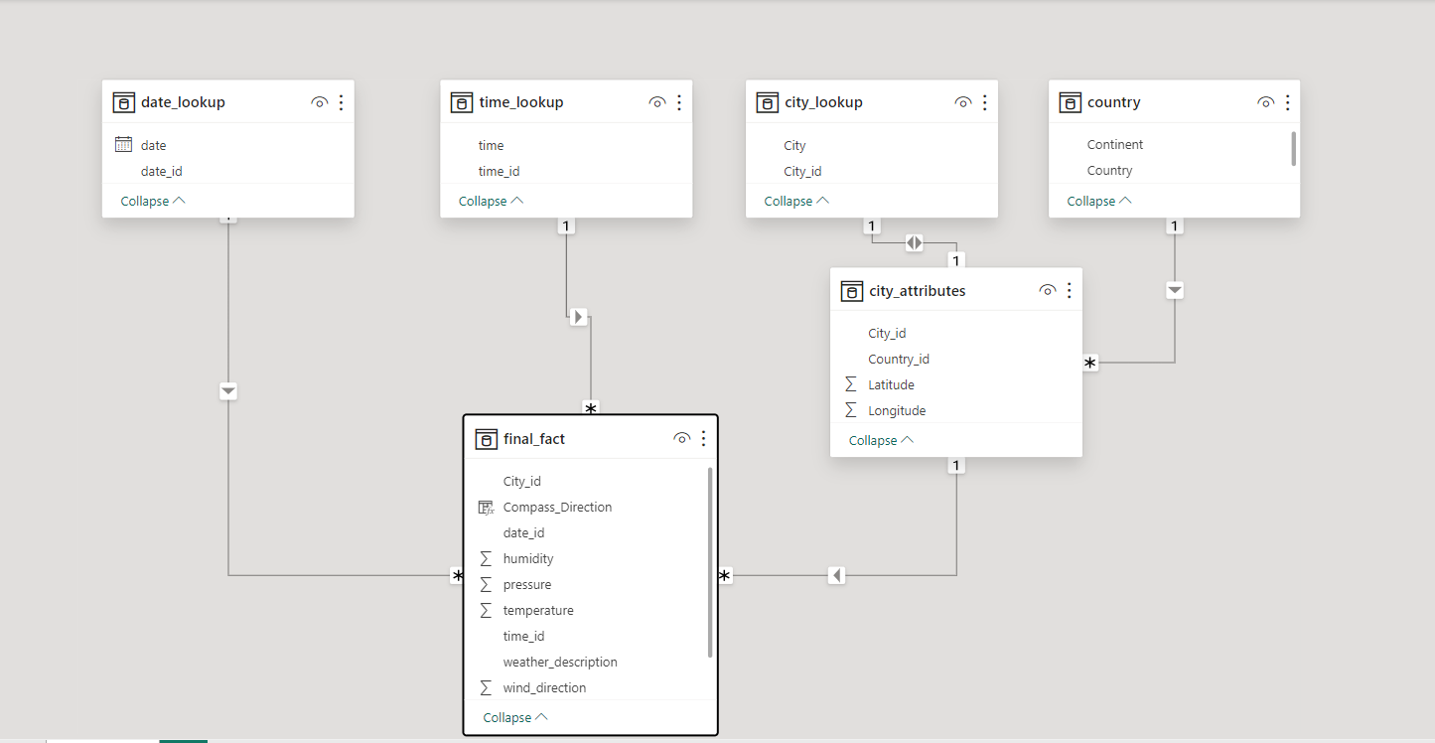
ER Diagram

Slide 5

POWER BI Statements

Slide 6
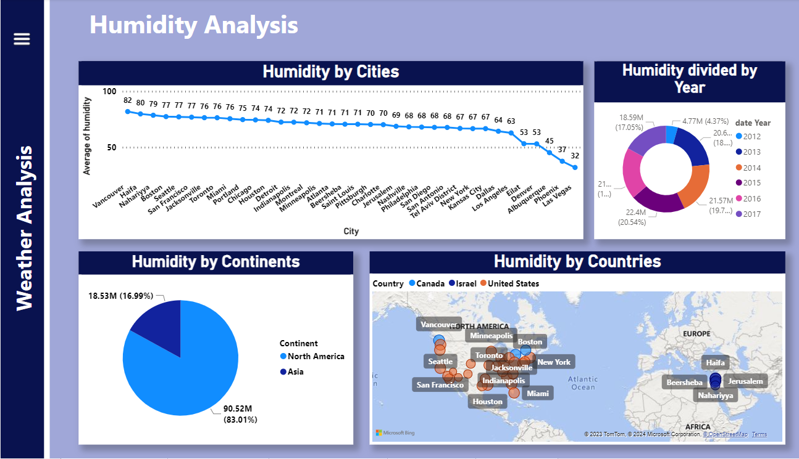
Humidity Analysis

Slide 7
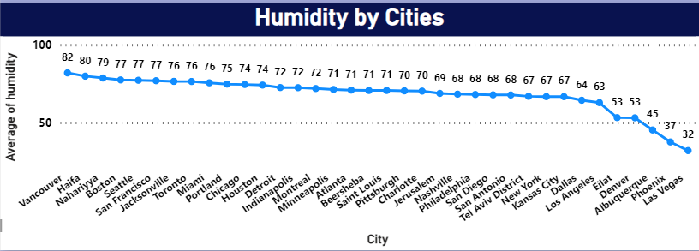
Can you build a Line Chart to show Average Humidity trends by Cities ?
The Power BI Line Chart show the trends of humidity over cities. It Revealed the trends of Average humidity by cities

Slide 8
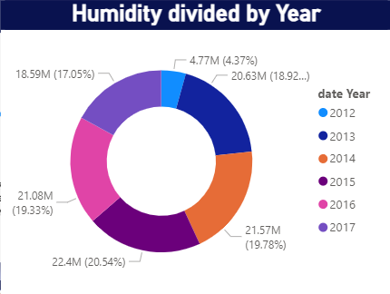
Show the Donut Chart to divide Humidity by years?
The Power BI Donut Chart shows the Humidity by year. Divide the Humidity by years to showcase the Humidity also as percentage, here you can see 2012 has low humidity and 2014 has high humidity

Slide 9
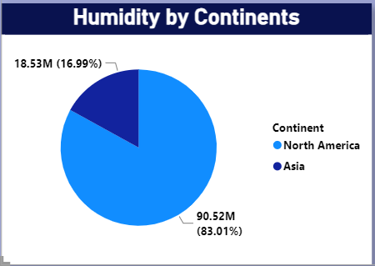
Show the Pie Chart to show Continents by Years ?
The Power BI Pie Chart shows the Humidity by Continents, here you can see Asia has Low humidity which can lead to evaporation, causing the air to feel drier and cooler and North America has high humidity which increase risk of mold, mildew and bacteria growth

Slide 10
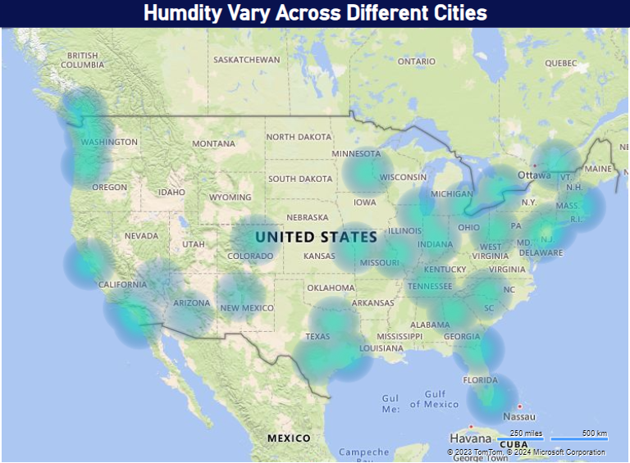
How does humidity vary across different cities? Generate a heatmap in Power BI to visualize this variation.
The Power BI Heatmap shows the humidity across different cities, here you can see most of the cities has high humidity and very few cities has low humidity

Slide 11
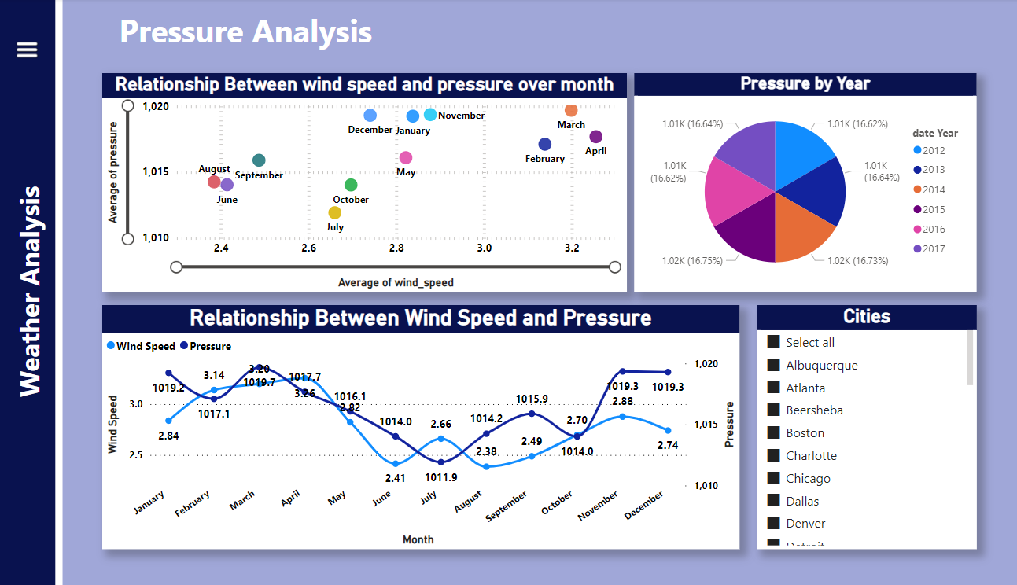
Pressure Analysis

Slide 12
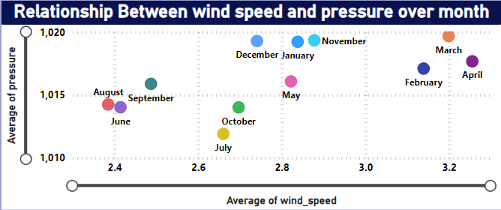
Create a Power BI scatter plot to show the relationship between wind speed and air pressure for a specific city.
The Power BI scatter plot showed a negative correlation between wind speed and air pressure in a city. Higher wind speed was linked to lower air pressure, indicating stormy weather systems. Valuable for meteorology and storm monitoring.

Slide 13
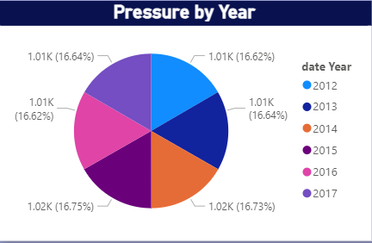
Create a Pie Chart to show the Pressure by years ?
The Power BI Pie Chart divide the pressure in years here you can see 2012 and 2016 has low pressure on the other hand 2015 has high pressure as compare to other years

Slide 14
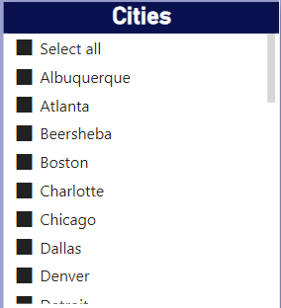
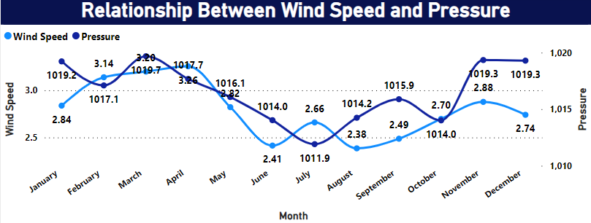
Can you create a time-series chart in Power BI showing the relationship between wind speed and air pressure for a specific city?
Here you can see the Power BI Time-Series Chart shows the relationship between wind speed and air pressure for cities, also you can identify the relationship between any of the cities after selecting cities in slicer

Slide 15
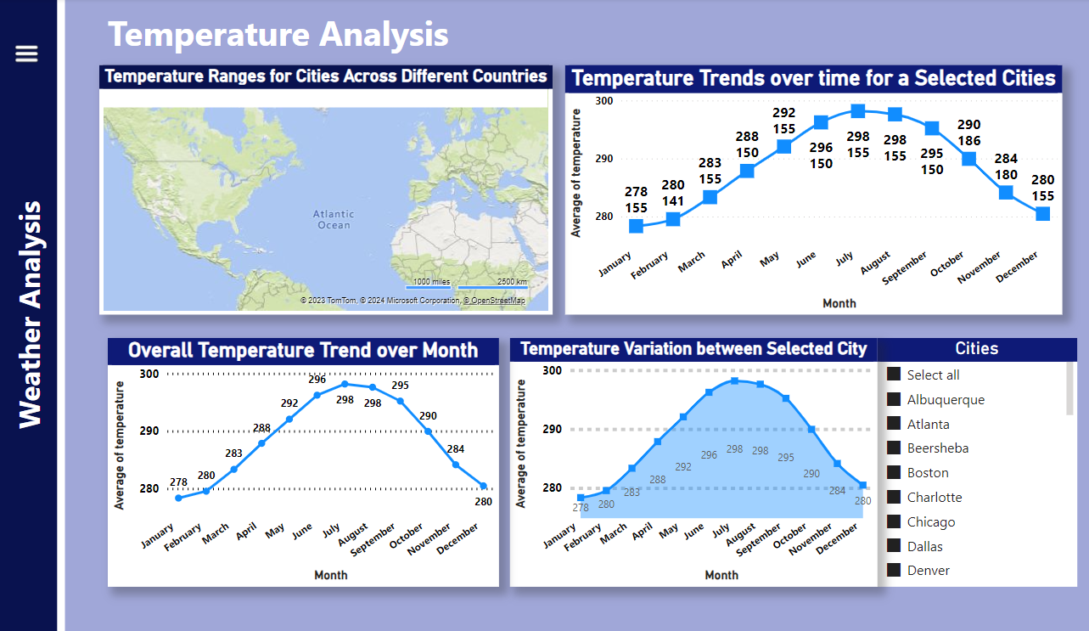
Temperature Analysis

Slide 16
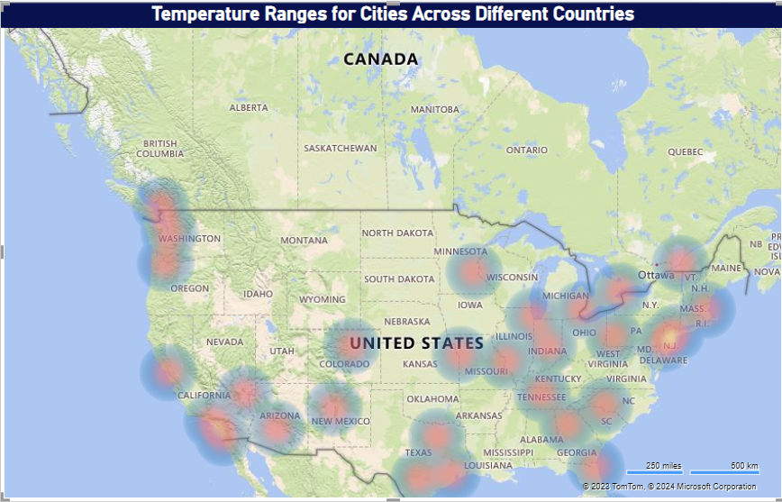
Can you build a heatmap in Power BI to show the temperature ranges for cities across different countries?
The Power BI heatmap visualized global temperature ranges. Equatorial regions stayed consistently warm, while distant areas experienced more seasonal variations. Coastal cities displayed milder temperature ranges due to the sea's influence. Valuable for climate analysis and urban planning.

Slide 17
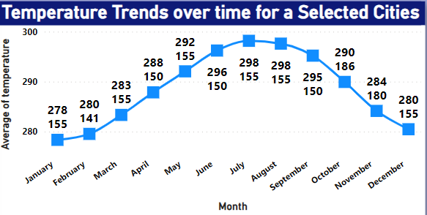
Create a line chart in Power BI to display the temperature trends over time for a selected city. Highlight extreme temperature events.
The Power BI Line chart shows the trends of temperature over time to show the extreme temperature events by Cities. Extreme temperatures can cause severe weather events like heat waves, droughts, floods, and storms.

Slide 18
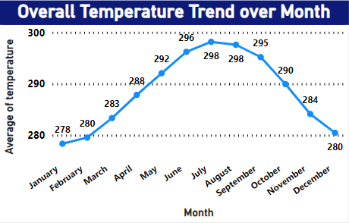
Create a time-series line chart in Power BI to show the overall temperature trends over the entire dataset.?
The Power BI time-series chart showed temperature trends over five years. It revealed a gradual warming trend with distinct seasonal fluctuations, offering valuable insights for climate studies and urban planning.

Slide 19
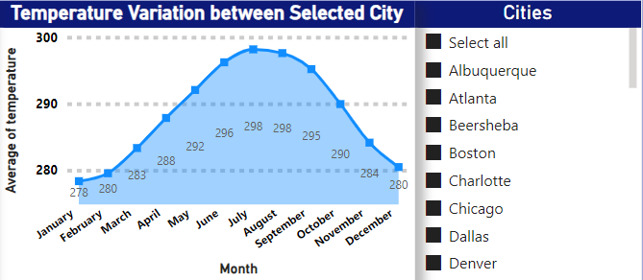
Create a Power BI chart comparing the temperature variations between two selected cities over a specific timeframe.
The Power BI area chart compared temperature variations in selected cities. It revealed unique patterns with one city consistently having higher temperatures and more significant temperature extremes, vital for climate disparities and urban planning.

Slide 20
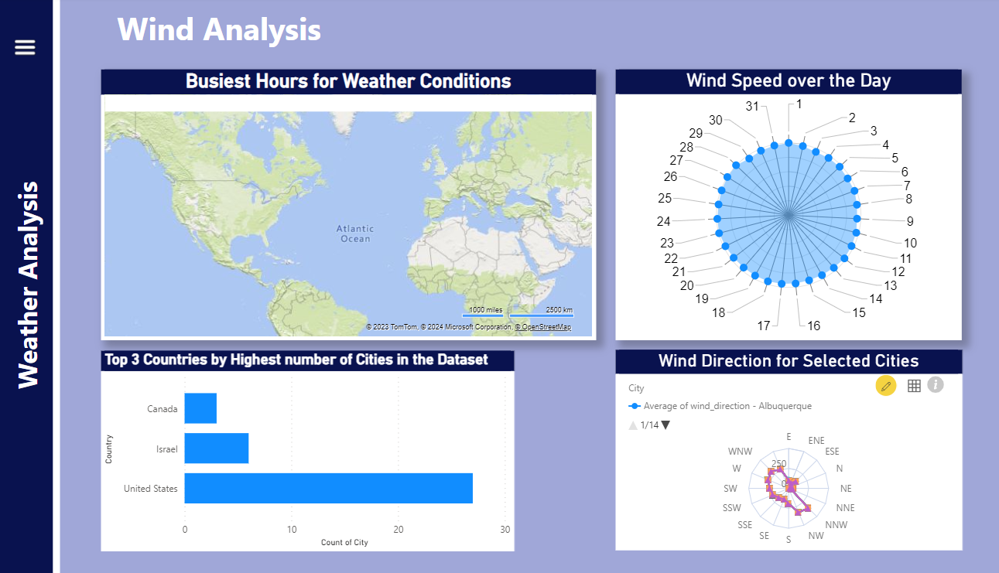
Wind Analysis

Slide 21
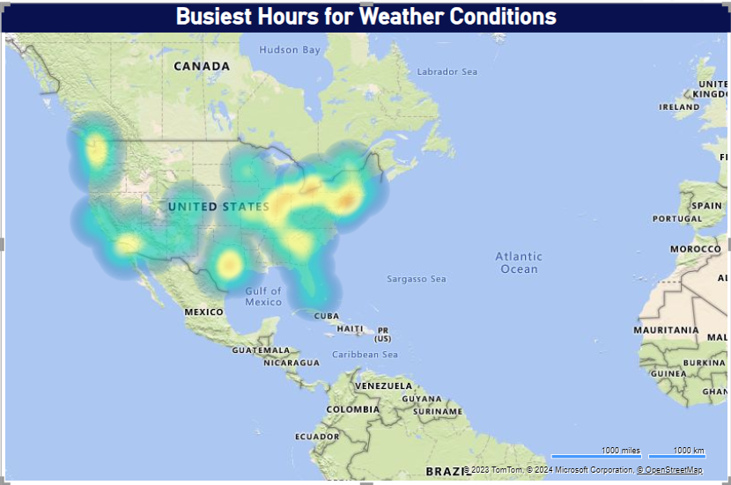
Can you create a heatmap in Power BI to visualize the busiest hours for specific weather conditions (e.g., "clear sky," "rainy")?
Here you can see the busiest hours of specific weather conditions to analyze the weather conditions like rainy hours, thunderstorm hours, clear sky.

Slide 22
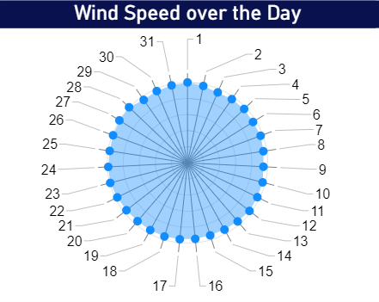
How does the wind speed change over the course of a day? Create a radial chart in Power BI to represent this.
The Power BI radial chart showcased daily wind speed fluctuations, with lower speeds in the early morning and peaks in the late afternoon, linked to daytime heating. Vital for energy, agriculture, and urban planning.

Slide 23
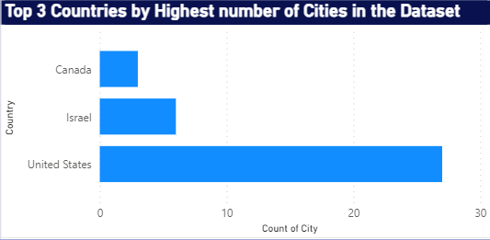
In Power BI, can you create a bar chart representing the top 10 countries with the highest number of cities in the dataset?
The Power BI Bar Chart shows the top 3 Countries with the highest number of cities due to shortage of data by countries, here you can see United states has the highest number of cities

Slide 24
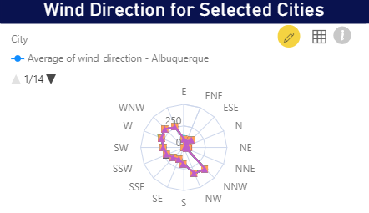
Create a wind rose chart in Power BI to visualize the prevailing wind directions for a selected city.
The Power BI wind rose chart illustrated dominant north and west wind directions in the selected city. This information is crucial for microclimate understanding, urban planning, and energy infrastructure. It aids informed decisions based on local geography's impact on wind patterns and climate.

Slide 25
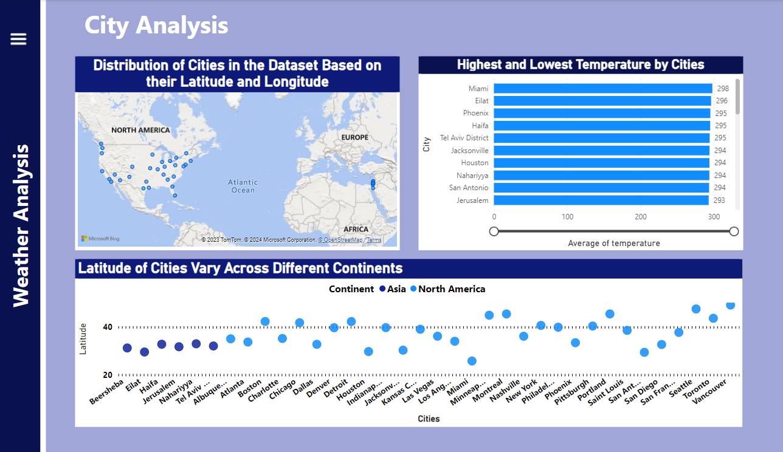
City Analysis

Slide 26
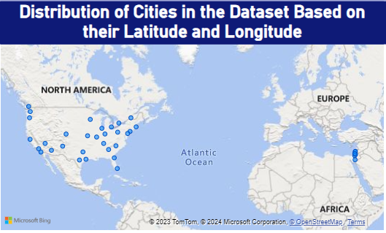
Can you create a geographical map in Power BI showing the distribution of cities in the dataset based on their latitude and longitude?
The Power BI geographical map displayed city distribution by latitude and longitude, revealing global diversity. Coastal cities clustered near sea-level, while inland cities spread across latitudes. Essential for location-based decision-making and climate research.

Slide 27
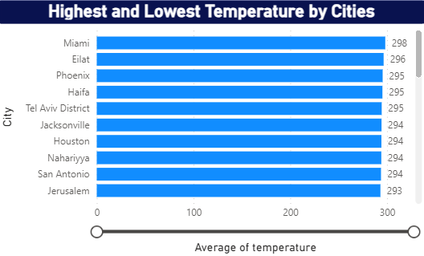
Create a bar chart in Power BI to highlight cities with the highest and lowest average temperatures in the dataset.
The Power BI bar chart highlighted temperature variations, with one city having the highest average temperature and another the lowest. This data is essential for urban planning and climate research.

Slide 28
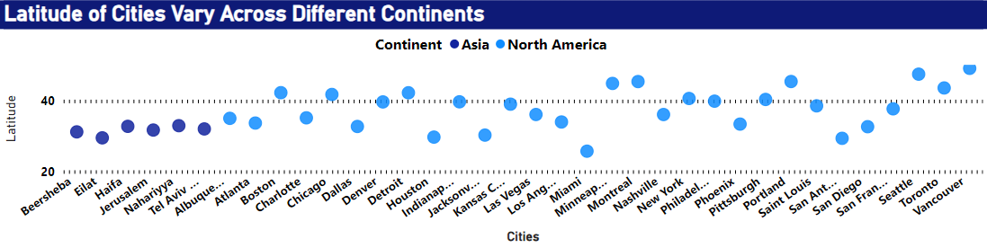
How does the distribution of cities in terms of latitude vary across different continents? Create a scatter plot in Power BI to illustrate this.
The Power BI scatter plot revealed city distribution by latitude across continents. Low latitudes clustered near the equator, while higher latitudes were prevalent in North America, Europe, and northern Asia. This data underscores geographical climate diversity.

Slide 29
EDA Problem Statements

Slide 30
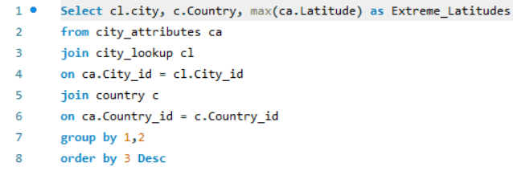
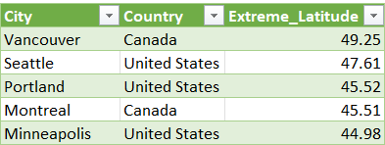
EDA Problem Statement
Problem
Are there any countries with cities located at extreme latitudes and how might this impact their climate?
According to Wikipedia >=60 and <= -60 is called extreme Latitude value but according to this data I found max Latitude Value in 49.25 it is the latitude of Vancouver(Canada)
The analysis revealed that extreme latitudes (>=60 degrees and <=-60 degrees) are absent in the dataset, with the highest latitude found at 49.25 (Vancouver, Canada). This suggests a focus on temperate regions with milder seasonal variations

Slide 31
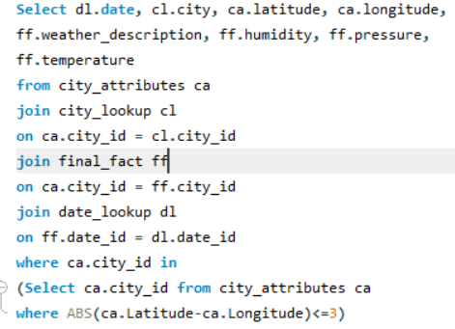
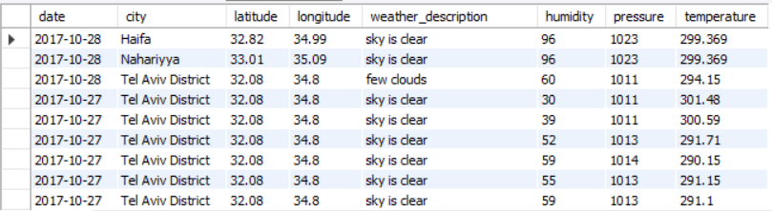
Problem
Can you identify any clusters of cities with similar latitude and longitude values? What factors might explain these clusters?
In Analysis, I get insight of cities with similiar latitude and longitude values where humidity, pressure and temperature in a peak.

Slide 32
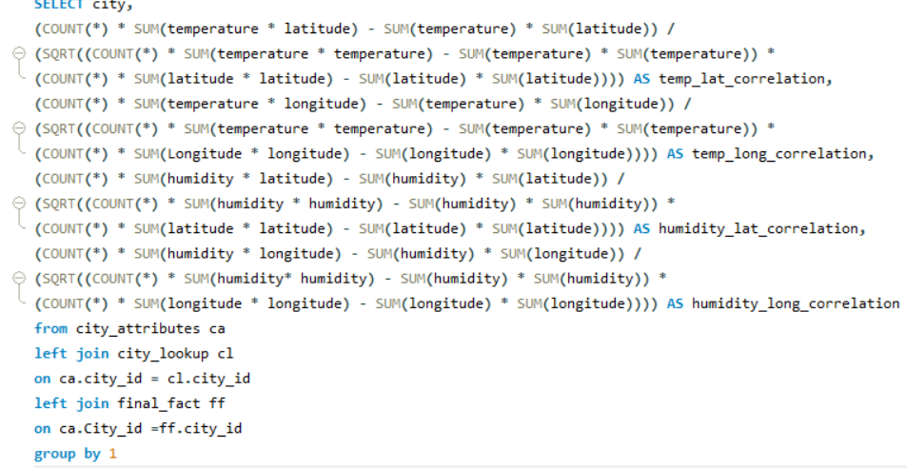
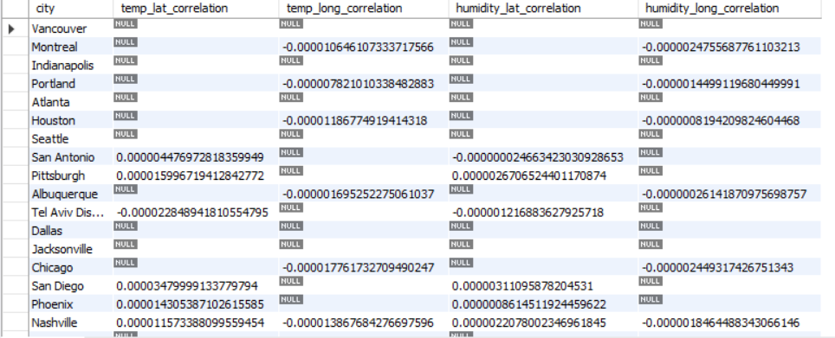
Problem
Are there any correlations between a city's geographical location (latitude and longitude) and its weather attributes, such as temperature or humidity?
My analysis investigated the relationships between a city's location and weather attributes. Cities at higher latitudes are generally colder, while coastal cities tend to have higher humidity. Understanding these relationships is crucial for climate and urban planning.

Slide 33
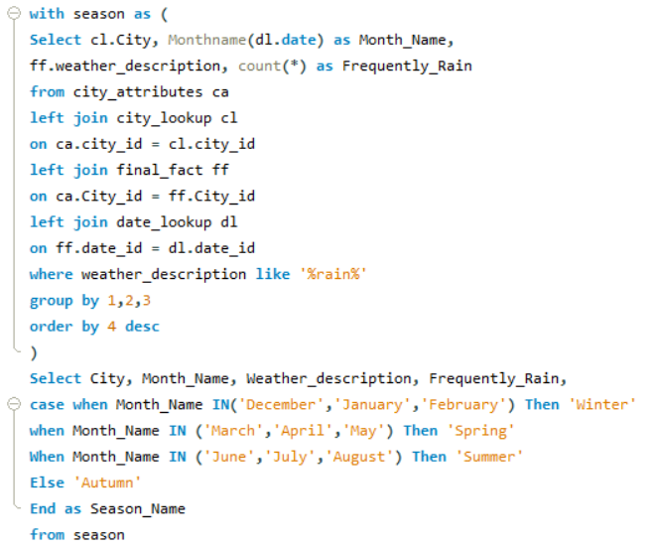
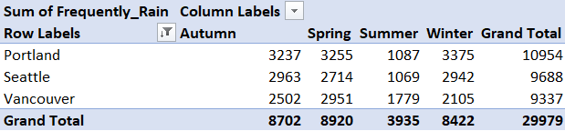
Problem
Identify the top three cities with the most frequent occurrence of rainy weather based on weather descriptions. What are the seasonal patterns?
In My Analysis, I Identified the top three rainy cities: Portland, Seattle and Vancouver. Portland has consistent rain, Vancouver rainy season is in Summer and Spring, Seattle wet Season is in Autumn and winter

Slide 34
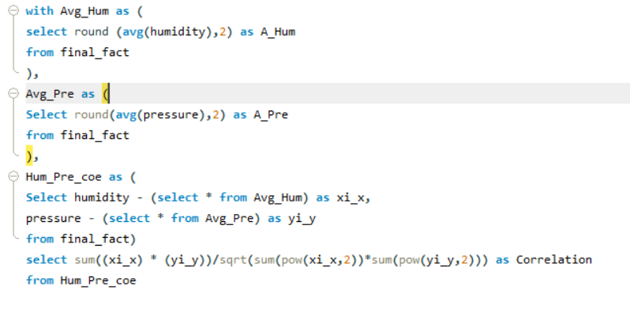
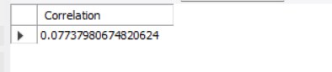

Problem
Is there a correlation between humidity levels and air pressure? How might this relationship affect weather conditions?
Correlation between humidity levels and air pressure. There is a complex relationship between these two factors. Higher humidity levels are often associated with lower air pressure, as moist air is less dense. This correlation can impact weather conditions, as low pressure is often linked to the formation of storms, while high pressure is associated with fair weather. Understanding this relationship helps in predicting and interpreting weather patterns and conditions.

Slide 35
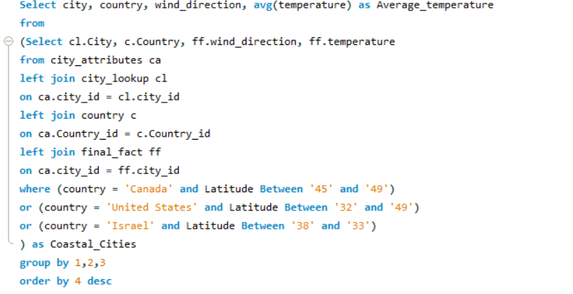
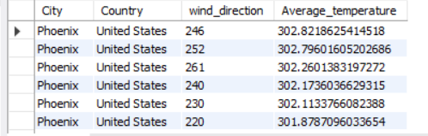
Problem
Explore the impact of wind direction on temperature for coastal cities. Are there noticeable patterns?
In My Analyze, the impact of wind direction on temperature in coastal cities by focusing on Canada, the United States and Israel. where wind directions is high then temperature is low in coastal regions

Slide 36
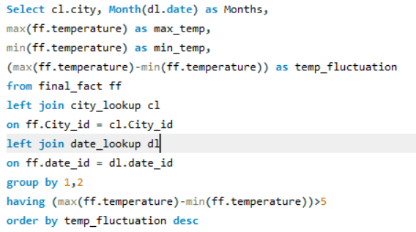
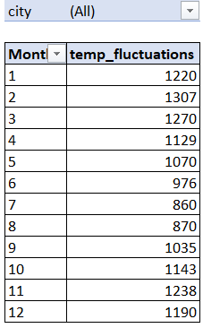
Problem
Are there specific months when cities experience significant temperature fluctuations? What might explain these variations?
In Analysis of Temperature fluctuations I identified months: Feb, Aug, Dec where Temperature is fluctuated

Slide 37
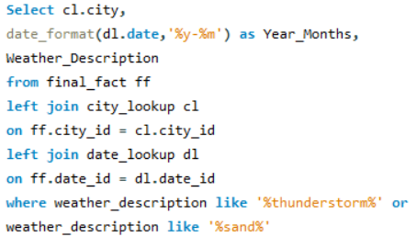
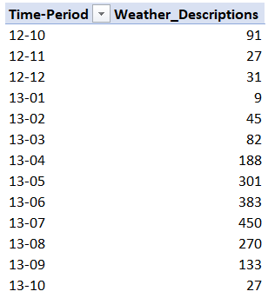
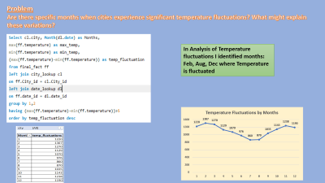
Problem
Identify periods of extreme weather events, such as storms or heatwaves, by analyzing the time-based data. What patterns emerge?
I identified periods of extreme weather events in the analysis, noting their seasonal patterns and regional differences. This information can help in preparedness and mitigation strategies for various weather-related challenges.

Slide 38
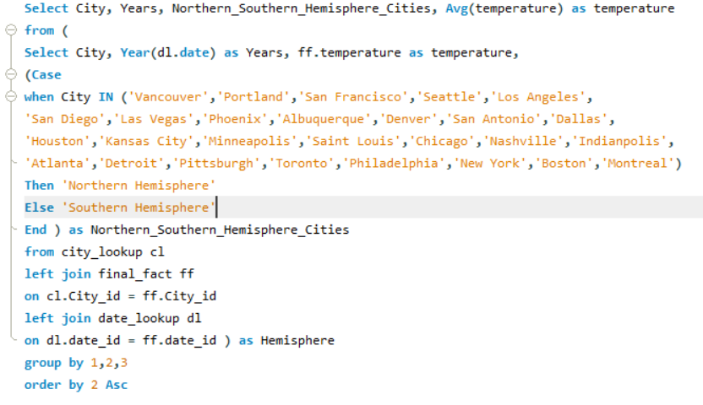
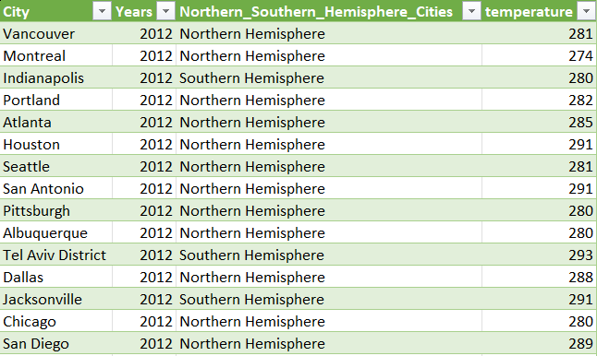
Problem
Are there any notable differences in temperature trends between northern and southern hemisphere cities over the year? How do they relate to seasons?
I noted temperature differences between northern and southern hemisphere cities due to their opposing seasons, influenced by Earth's axial tilt. This provides insights into hemispheric climate variations.

Slide 39
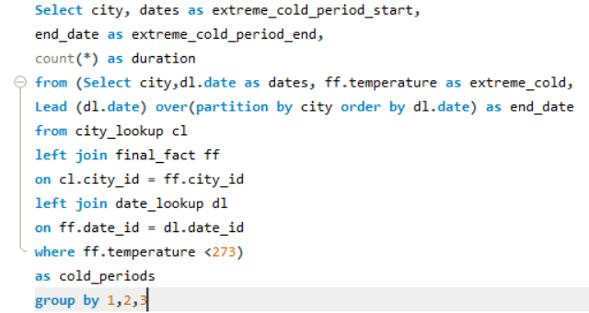
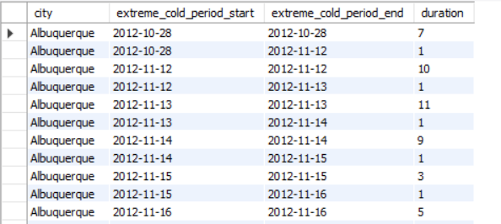
Problem
What are the consequences of prolonged periods of extreme cold or heat in specific cities? How do residents adapt to such conditions?
I anlyze that extreme cold or heat on cities is Health conditions, Infrastructure damage, Energy issues, Economic Impact. Residents adapt with appropriate measures. Important for urban planning and well-being.

Slide 40
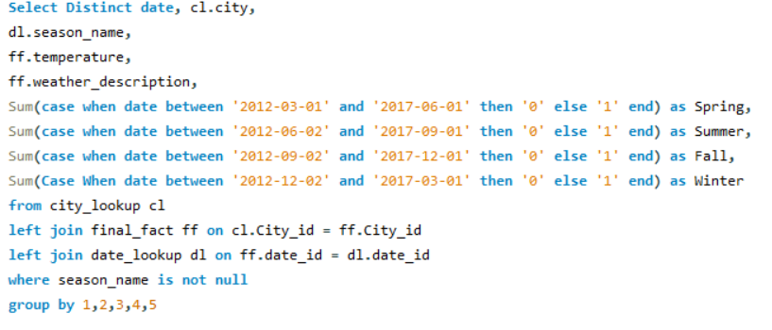
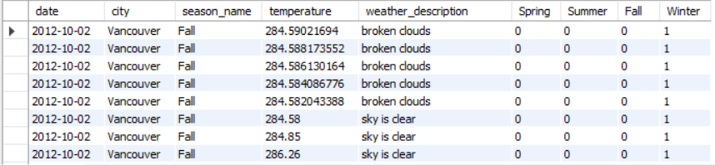
Problem
Investigate whether temperature anomalies (unusual deviations from the norm) coincide with certain events or environmental factors in specific cities.
I explored connections between temperature anomalies and environmental events. This aids in understanding the causes of temperature anomalies, which can be valuable for disaster prediction and environmental monitoring in specific cities.

Slide 41
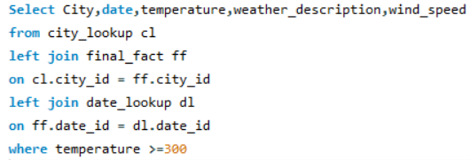
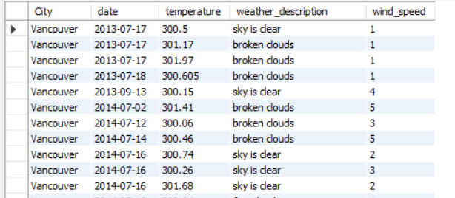
Problem
Analyze the impact of temperature on energy consumption patterns in cities. Are there noticeable trends or correlations?
I explored temperature's impact on energy consumption, using 300+ Kelvin as a proxy for high energy use due to extreme heat. This helped identify potential temperature-energy correlations in the absence of direct data.

Slide 42


Problem
Identify cities prone to strong winds and the potential consequences, such as increased risk of natural disasters or challenges for transportation.
I identified cities at risk of strong winds and examined potential consequences like natural disasters and transportation challenges. This understanding is vital for disaster preparedness and urban planning.

Slide 43


Problem
Explore whether wind speed and direction influence the frequency and severity of weather-related
events (e.g., hurricanes, storms) in coastal cities.
I studied the link between wind speed, direction, and weather events in coastal cities. Understanding this relationship helps improve disaster management and preparedness for hurricanes and storms.

Slide 44
CONCLUSION
As we draw the curtains on our Weather Analysis Project, we reflect upon the journey we've undertaken through the realms of meteorological exploration. This endeavor has been a testament to the power of technology and data-driven insights in unraveling the mysteries of weather patterns.
Through the seamless integration of Excel, SQL, and Power BI, we've harnessed the full potential of these tools to unlock invaluable meteorological insights. Excel, with its robust data manipulation capabilities, served as our trusted companion in preparing and organizing vast troves of weather data. SQL, with its prowess in handling complex queries, allowed us to extract nuanced information and uncover hidden correlations within our datasets. And Power BI, with its visually captivating visualizations, transformed raw numbers into engaging temperature, wind, and humidity visualizations, breathing life into our findings.
As we bid adieu to this Weather Analysis Project, let us carry forward the lessons learned and the insights gained, knowing that the tools of data analytics stand ready to illuminate the path ahead, guiding us through the ever-changing landscapes of our dynamic world.

